Slide 1
HUNTINGTON CHAPEL
VBS 2024 June 24th-28th
SCUBA
Diving Into Friendship With God
Take kids deep into an amazing undersea adventure where they’ll experience the ever-flowing, never-ending love of God. At Scuba VBS, kids will be immersed in the Word and discover what living water is really all about!

Slide 2
The Leader Agreement (for all staff)
Expectations for Crew Captains & Crew Leaders, and campers
The Registration/receiving& releasing Process
Rotation/Stations and Leader Involvement
Handling Situations
VBS / Bible Message

Slide 3
LEADER AGREEMENT: Please read and sign below *
It is our desire to have a great VBS for the children and staff! The success of our program depends on the attitudes and conduct of our team.
You as a Huntington Chapel VBS volunteer agree to;
conduct yourself in a Christ-like manner (w/ words & deeds)
be encouraging & upbeat
engage campers & others in the activities
refrain from using your cell phone
wear a watch to keep track of time changes between stations
keep all campers & staff safe, refrain from inappropriate touch (i.e frontal hugs, piggy back, lap holding, hand holding w/ only 1 camper)
attend staff planning meetings and/or training/orientation meetings
be good role models
dress appropriately (shorts should mid thigh, wear vbs tshirt)
be on time each day (start 8:30am for meeting & prayer time) (kitchen is closed @ 9am to crew leaders)
engage all campers to participate appropriately & safely
Captains connect kids to parents/guardians at closing
help at one of the stations afterwards until 12:45/1pm
participate at the closing picnic
HS students; bring your community service form to be signed
If you need to be reached during camp, please give your friends & family the following phone numbers: Huntington Chapel Church Office (203) 929-1222, Pam Nitsche (203) 906-4031(VBS Director), GeJuan Williams (203) 909-4779 (Elder), or Pastor Doug Steeves 395-3118.
It’s going to be a great week! Thank you for serving.
Please sign and return to VBS Director
______________________________ ____________
Volunteer Signature Date

Slide 4
Captains
Captains are responsible to oversee one of the 4 groups and to be a support for the needs of the leaders and the kids in their crews. Sherpas have some of the largest responsibilities, so it is very important that they are there everyday from beginning to end, and that they understand all the protocols thoroughly!
Dealing with various/difficult situations: More on this later
Captains must be familiar with
1: the schedule/transitioning between stations
2:bathroom break protocol
3:the receiving/releasing kids to the parents.
Captains should keep their eye on the crew leaders and make sure that they keep their kids with them, and always follow the 2 leader rule.
Captains will go ahead of the group to see if the group at the next station is ready before bringing their group in. No one should let their kids run off to the next station. The leaders must always be in front of the kids, and wait until they get the signal from the captain that they can bring their kids into the next station. Do not bust into the next station. Make sure that they are ready for you.
Captains will help get the attention of the kids by calling for the leaders to help quiet the kids down “leaders quiet your group down” before the leader instructs the kids. An attention getting cheer/clap would be great!

Slide 5
Crew Leader Excpectations
SMILE, and have fun!
Be a positive Role Model by your language (No swearing, inappropriate conversations, talking negatively about anyone) & modest attire (loose fitting staff T-Shirts with no exposed midriff, 3 inch inseam on shorts)
Hand in your cell phones & focus on your kids (Don’t get distracted by your peers)
Use each childs’ names in kind and loving ways daily, give high fives throughout the day.
Circle up during snack time & discussion in Kid Vid Cinema
Be an active tuned-in listener during discussions
Get to know your crew members
Keep Children Safe – never leave them alone or let anyone go off by themselves or run ahead. Always go before them. Anticipate that some will want to run off right after the station so position yourself accordingly
Help the leaders get the kids’ attention-When station leaders are talking, quiet your kids down, stay close
Reinforce Power Response

Slide 6
continued…
Proper Interaction
To protect both you and all children who come to VBS make sure to follow the below guidelines.
Acceptable: high-fives, side hugs, games of tag, staying in groups/pairs, giving all kids equal attention.
Not acceptable: front hugs, tickling, piggy back rides, sitting on your lap, wrestling, being alone with a child, showing favoritism to any child.
*Always remember the 2 leader rule. Children should always have 2 leaders with them at all times!!!
*Do not touch a child anywhere that a bathing suit would cover him/her.

Slide 7
Roles/jobs for the campers
1: Guide: Chooses action ideas of how the crew will travel (ex: swimming, paddling, roll like coconuts, crab walk, etc..)
2: Kit Carrier: Distributes and collects supplies, and helps to carry the Crew’s bag
3: Prayer Person: Leads or opens prayer times
4: Navigator: Helps monitor the daily schedule to let the crew know what’s coming next
5: Thank You-er: Leads the crew in thanking station leaders every day.

Slide 8
Receiving Campers
Someone will be positioned at the sanctuary door who will direct each child to the correct captain of his/her group.
The Captain will then direct the child to the correct crew.
Crew leaders will have assigned spots in the sanctuary and will receive their campers from the captain.
If any camper is new, the crew leader is responsible to make sure to 1: receive a medical card for the child, and 2: that each child has a name tag with a colored dot on it. If either of these are not present the crew leader must notify the Sherpa immediately who will message the registrar for this information. This must be done asap as soon as this is noticed. If you lose this card at any point in the week ask the registration booth for another one asap.
Keep any medical or allergy conditions confidential and do not discuss them with anyone besides with the captain, director, nurse, registration or station leader. Do not leave their medical card out. Leave it in your pouch at all times except when you need to refer to it.
Be familiar with your child’s condition at all times, and what may be needed. Know if your camper is allergic to bees and carries an epipen, and what your role is.

Slide 9
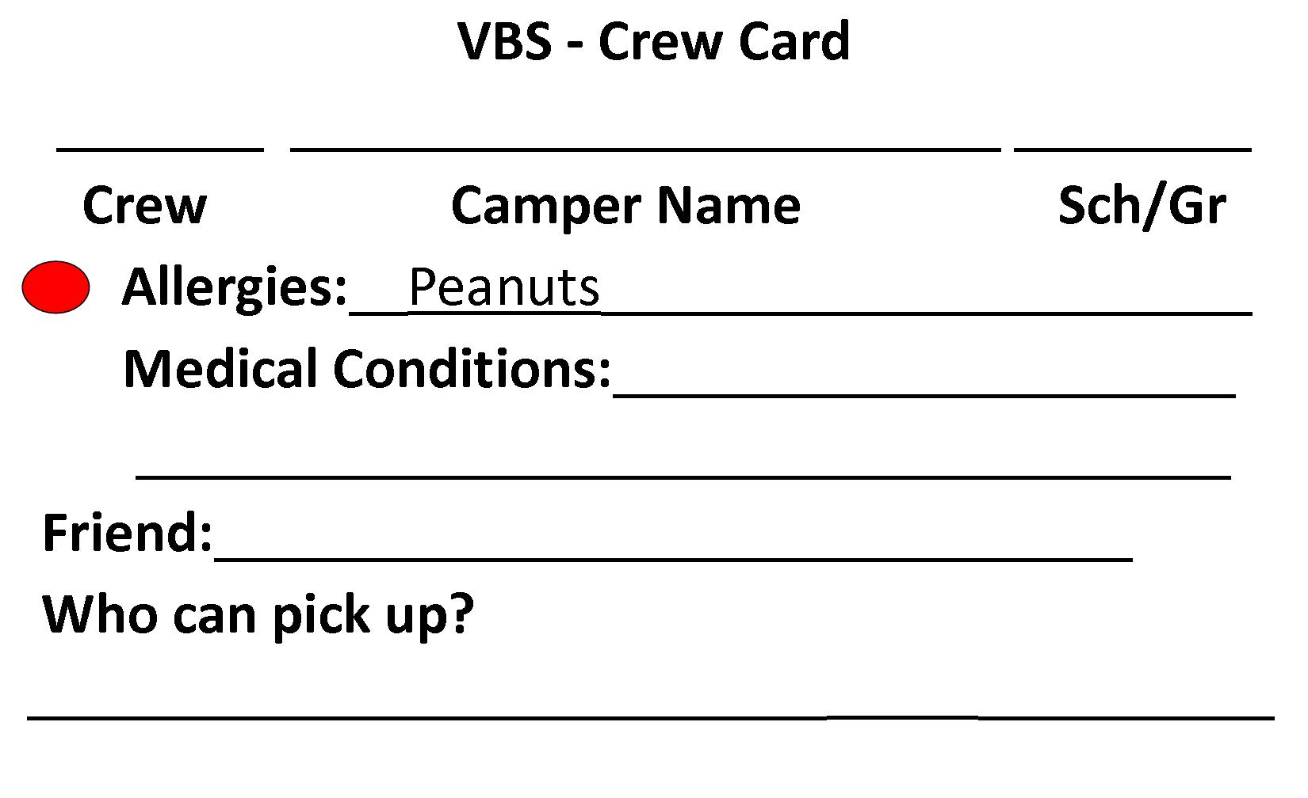
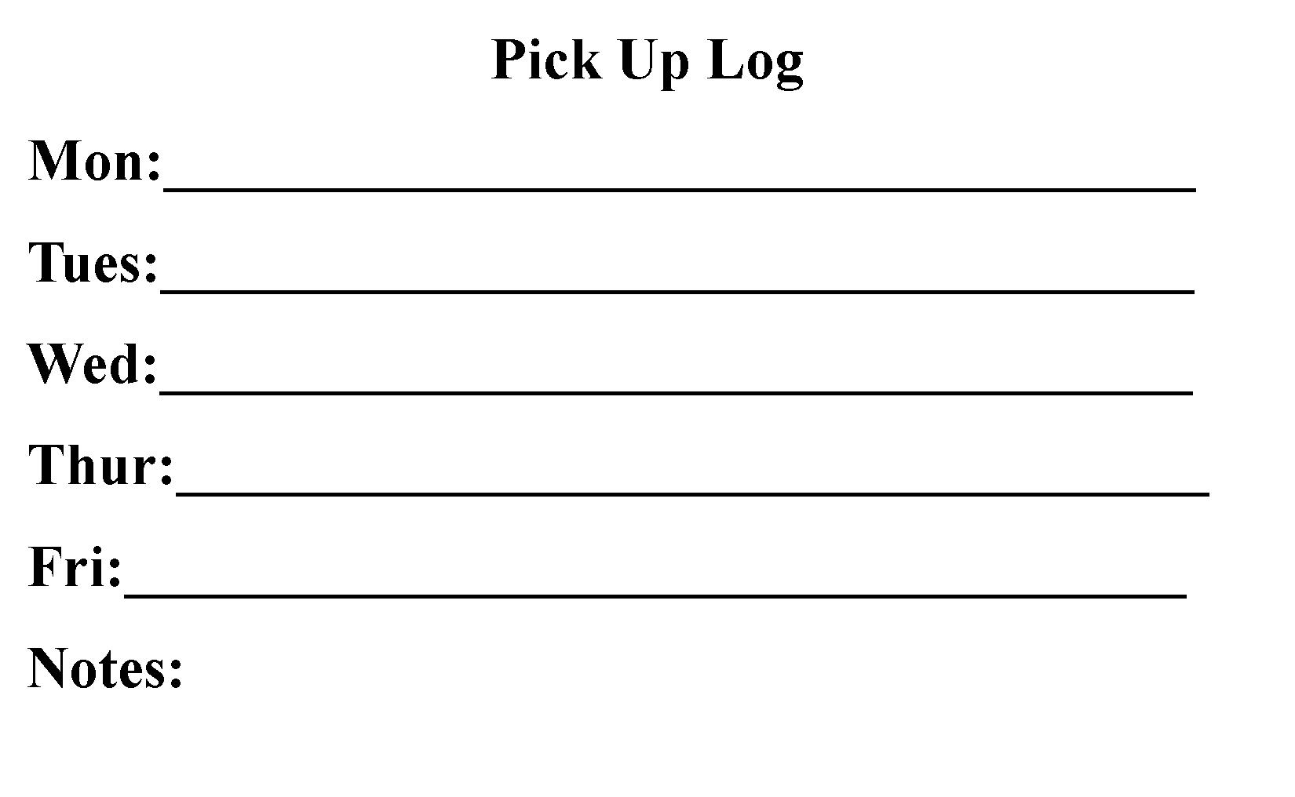
Receiving Campers
This is what the cards look like:
Medical card for the leader to keep in pouch-2 sided
Front Back
Name Tag for the kids to wear
Allergy
Colored dot symbols
Red = Food Allergy
Blue=Medical/Allergy
Yellow/green=
No known conditions
Allergy
Child’s Name
Crew #

Slide 10
Releasing Children to Parents
At the end of the day, you will sit with your crew and parents will pick their kids up.
You will have a card that lists the names of people who can pick the child up
Make sure that it is a name on the list.
Initial the back of the card as each child is picked up. Don’t just let the child go. Make sure that the parent is present and there is eye contact and/or communication between you and the parent picking up.
Scenarios: Someone comes in who is not on the approved pick up list (examples)
1: brother rushes in and says “Mom’s in the car we gotta go!”
2: Father comes but is not on the list (or comes mid-day)
In both cases, communicate with your sherpa who will handle it./Sherpas will communicate with the registrar. If no prior approval had been given: we may not release the child to the person until communication is made with the parent/guardian
Parent doesn’t come on time.
Once most of the parents have come, any remaining kids will be passed on to the sherpas of
the group-which will be announced. Make sure to pass on the child’s medical card, and the sherpa will initial it when the child is passed on to the parent.
If there are kids remaining for a significant time: 2 captains(or adults who agree to stay until
the kids get picked up) will remain until the last child is picked up. Calls may need to be
made home and/or to the emergency contact person if the parent does not come by 12:20pm
and will be determined by the director and/or registrar.

Slide 11
EX-Day Time | Group A (Crews 1-3) | Group B (Crews 4-6) | Group C (Crews 7-9) | Group D (Crew 10-12)
8:30- 8:45 | Crew Leaders sign in, meet for prayer & announcements in Chamberlain Hall
8:50 – 9:00 | Crew Leaders meet kids in Sanctuary
9:00 – 9:30 | Assembly Time Sing & Play (Sanctuary)
9:35 – 9:53 | Rec Games (Field) | Reflection Time aka Kid Vid Cinema (Sanctuary) | Bible Discovery (Farm House) | Imagination Station (Tent)
9:58 – 10:16 | Bible Discovery (Farm House) | Imagination Station | Rec Games | Reflection Time
10:21 – 10:39 | Snack Time (Tent)
10:44-11:02 | Reflection Time | Rec Games | Imagination Station | Bible Discovery (Farm House)
11:07 – 11:25 | Imagination Station | Bible Discovery (Farm House) | Reflection Time | Rec Games
11:30 – 12:00 | Assembly Time (Sanctuary)
12:00 – 12:10 (T,W,R,F) 12:10 – 12:30 | Children Connect with Parents (T,W,R,F) Crew Leaders Assist stations in field

Slide 12
RAIN EX-Day Time | Group A (Crews 1-3) | Group B (Crews 4-6) | Group C (Crews 7-9) | Group D (Crew 10-12)
8:30- 8:45 | Crew Leaders sign in, meet for prayer & announcements in Chamberlain Hall
8:50 – 9:00 | Crew Leaders meet kids in Sanctuary
9:00 – 9:30 | Castaway Sing & Play (Sanctuary)
9:35 – 9:53 | Bible Discovery (Chamberlain Hall) |  | Kid Vid Cinema (Sanctuary)
9:58 – 10:16 | Kid Vid Cinema (Sanctuary) |  | Bible Discovery (Chamberlain Hall)
10:21 – 10:39 | Tropical Treats (Tent)
10:44-11:02 | Ship Rec Games (Sanctuary) |  | Imagination Station (Chamberlain Hall)
11:07 – 11:25 | Imagination Station (Chamberlain Hall) |  | Ship Rec Games (Sanctuary)
11:30 – 12:00 | Sail Away Send Off (Sanctuary)
12:00 – 12:10 | Children Connect with Parents
Rain

Slide 13
Rain Schedule | Group A | Group B | Group C
8:30- 8:50 | Crew Leaders sign in, meet for prayer & announcements in sanctuary
9:00 – 9:30 | Assembly Time (Sanctuary) and Kid-Vid Cinema Part I
9:35 – 9:55 | Rec Games (Sanctuary) | Imagination Station (tent) | Bible Discovery (Kellogg Hall)
10:00-10:20 | Bible Discovery (Kellogg Hall) | Rec Games (santuary) | Imagination Station (tent)
10:25-10:45 | Snack Time (Tent)
10:50-11:10 | Imagination Station (tent) | Bible Discovery (Kellogg Hall) | Rec Games (sanctuary)
11:05-11:20 | bathroom break | bathroom break | bathroom break
11:25-11:55 | Assembly Time (Sanctuary) and Kid-Vid Cinema Part II
12:00 – 12:30 | Children Connect with Parents (T,W,R) Crew Leaders Assist stations in field

Slide 14
Stations / Leaders
Preparation is vital - have all supplies ready, and be ready to adjust when necessary
Utilize crew leaders to help facilitate small group discussions or activities
Speak with crew captains when/if necessary
Clean up at the end of each day

Slide 15
Before Opening Celebration
Arrive by 8:30 sign in & meet with the director (Pam), captains & crew leaders in Kellogg Hall, transition to sanctuary for prayer & discussions
Locate your crew backpack, blanket, & registration list noting any child with allergies
At 8:45 move into Song/Dance, greet campers & gather your crew, making sure the kids know each other's’ names & wear their name tags.
Get campers excited for the day ahead

Slide 16
During & After
Sing & Dance (Sanctuary): PARTICIPATE! WORSHIP! Follow the hand motions and sing out loud while encouraging your group to do the same! Set the example for your kids. The more that you get into it, the more they will as well!
Assign Jobs for the day within your Crew
Check your Schedule, collect your campers, Backpack & Blanket and move to next activity quickly – there is only 5 minutes in between
Rotate to stations: be sure to have a crew leader on all sides of campers

Slide 17
Stations
Bible Discovery (Farm House): Each crew will be assigned a color that you will use for the entire week. These colors will be used for crew stations. Sit in a circle with your Crew, on the sheet provided for you-the position of these may change daily. Encourage the kids to listen & participate. Engage them in the conversation when time is allotted for that.
Rec Games (Field): Encourage them to listen to instructions and YOU participate in the games as well. Groups will be chosen by their colors. If it rains, Games will be held in Kellogg Hall.

Slide 18
Imagination Station (Tent): Go to the assigned table for your crew (look for your crew color on the table-which may change position daily). The 1st and last day, you will sit on sheets. Kids are to stand on the outside part of the table so that they can see the station leader in the center, and crew leaders are to stand behind them so that they can see the station leader as well and help the kids to understand the instructions. They are to encourage the kids to listen to instructions & assist them with their activity, ensuring that they label their take home gadget with their names & collect them in the Crew Backpack. It is important at this station that the leaders help to focus and understand what the leader is saying. This is not a time to socialize with friends
Kid-Vid Cinema (Sanctuary): A leader will reinforce the daily Bible Verse and Point. Crews will have time to work on their Bible Memory Verse & earn their Keepsake of the day. At the start, a video will be shown (the children can sit together and the adult leaders make a perimeter & stay close in case a child needs to be re-engaged. Afterwards, leaders will sit in a circle with their group on the color sheet provided and lead a discussion (reflection). Beginning on Day 2, if time permits, help each camper name a “God Sighting.”

Slide 19
What is a God Sighting, you ask?
God guided & provided to his people long ago but we can still see God at work today in our lives. We see the blessings of health, clean water to drink, a kind word from someone or something beautiful or unexpected in nature.
Our God Sightings remind us that we are on a journey through life, even when we face tough things like loneliness, a new school or sickness. God is still around us. When we take the time to see what God is doing it helps us trust God every step of the way!

Slide 20
Snack Time
Get your kids situated on your crew blanket and wait for the trumpet blast. At the trumpet blast quiet down your crew and have them listen to instruction.
The first day help the “Prayer Person” in your crew to thank God for their snack
Help kids collect their snack & return to your crew blanket
Once finished, make sure that everything is thrown out properly.
If you have extra time, introduce the idea of a “God Sighting” (you can share one of your own) and help students learn the Bible Verse of the Day
After snack, this time will be setup like recess. Various stations will be available to them, and adult leaders should either be at a station or forming a perimeter, not allowing any kids to wander off. If you are not watching a station, be sure to stand at the perimeter and do not let kids go past you.
If needed, a signal will be given and all leaders and kids are to return to their blankets. Crew leaders may be asked to raise your hand if someone is missing in your group. Names of kids on bathroom breaks will be reported via walkie talkie, and if someone is missing the overseer will take care of it.
This is a good time for bathroom breaks. People will come around to groups and bring kids in groups if they need to go.

Slide 21
Closing Time
Closing Assembly: Get your Crew back to Sing and Dance Station (Sanctuary) by 11:30
Stay together, encourage them to listen to the leader
Join in the singing & hand motions
At the conclusion, collect their Keepsakes & Name Tags. Assure them you will keep them safe until they return tomorrow.
Place ALL the Name Tags in the labeled Ziploc bag, that you MUST put into the name tag bin in Kellogg Hall.
STAY IN THE SANCTUARY WITH THE CAMPERS, THEIR PARENTS WILL MEET YOU AT THE DOOR TO THE SANCTUARY
Ensure that they take their Imagination Station gadget home.
Only release them to their parent/guardian or anyone who they listed at registration for pickup.
Return your Crew Backpack to Kellogg Hall
After your crew has met their parents, please come to the field Mon-Friday to assist with the stations (Zipline, tarzan swing, etc…). Monday will be simulated training for leaders.

Slide 22
Friday Night Picnic
Please come to the VBS Celebration Picnic at 6:00pm the last day of VBS. You will earn additional community service hours and can receive your community service form at that time.
Join your crew as they perform A FEW songs for their families, enjoy a “potluck” picnic, the waterslide, the zip line, and other stations.
There will be other fun activities as well.
See photos of the week & meet your kids’ families

Slide 23
Community Service Hours
Make sure you check-in each morning at 8:30 with the director (Pam) in Kellogg Hall for attendance. We will assume everyone will stay until 12:40/1pm. If you are unable to do so, please let Pam know ASAP.
Please bring your community service paperwork BEFORE Friday if possible. If you need more hours, we can use help setting up decorations, and taking them down after VBS, and there are other fun events for the kids that you can help at throughout the summer. Please let us know if you can join us ☺

Slide 24
Challenging Situations
My Crew won’t stay together while traveling between stations
Encourage your guide to come up with creative ways to travel, or to come up with a cheer that they can all say together while walking.
Note: It is important that the group stay together, therefore leaders must focus on their kids, and not get distracted talking with other leaders
My child will not listen to me
If a child in your crew does not follow your instructions, stop the child by saying “look at me,” and once you have eye contact explain to him/her that it is important that everyone follow the instructions and that the day goes better when everyone does that. If the child will not stop the disruptive behavior or continues to not listen ask the Sherpa for help. The Sherpa will step in and talk with the child. Update the Sherpa how it is going. If the problem continues the child may need to switch to another group or be asked not to return.
If you have an overactive child
Pair the child with yourself during partner activities, and suggest that the child sit with you during quiet times. If this doesn’t work, you may need to ask the director to assign you an assistant crew leader to help the child focus and participate.
If they won’t participate
Help shy people participate by calling them by name to answer the question/ or give them something to lead “can you find us a spot to sit?”

Slide 25
Bathroom Usage
What are we looking for?
We need to make sure that no children 1:wander out somewhere else and lose track of him/her. We also need to protect from 2:potential bullying of other kids, or 3: adult interaction in the bathroom (for the protection of the kid and the adult).
Adults are not to use the bathroom when another child is in there, so please go to the bathroom before we start. Adults are to use the 2 office bathrooms during VBS time, but make sure that another crew leader/Sherpa agrees to watch your kids in that time.
Do not go to the bathroom during a transition. Make sure that your kids are set at the next station, then go to the bathroom. (the same is true for bringing your kids to the bathroom). Need to discuss this further…
If a child needs to use the bathroom (field and Outside tent)
Have the Sherpa message the overseer to send out people to escort the child. If other adults are available, feel free to have 2 adults in the area take the child. Kids in the field may go to the office bathroom by entering the front part of the building. Only one child is to be in that bathroom at a time. DO NOT BRING MORE THAN 2.
*Good Communication is needed at all times. Do not just say “I’m bringing Jack and John to the bathroom, watch my kids” and take off. Rather make sure that you are heard and the other person agrees to watch your kids.
The captain will 1st make sure that no one is in the bathroom, then stand at the doorway with the door open, in the line of site of other leaders If the sherpa needs to go into the hall or bathroom, they are to call another leader with them.

Slide 26
Utilize the captain & director: They are there to help with any situations that are challenging. Each Sherpa has a walkie-talkie to communicate any situation with the overseer. For this reason: captains must ALWAYS be with their group to be ready for any emergency from kid drop off until the last child is picked up, and they should never bring kids to the bathroom from outside. If a sherpa needs to use the bathroom or leave the group for a reason, he/she must communicate with another mature adult to take his/her place for the time needed.
General Principles:
1:Stay Calm (even if you’re nervous or panicking on the inside)Keep a calm face and voice
2: Lost Child/Emergency Situation: Stay calm and communicate the situation with your Sherpa who will handle it. If you panic it will cause the kids to become anxious and make the situation worse. If there is a lost child, the Sherpa will call it in to the overseer who will handle the situation.
-If a medical emergency, crisis, escalated situation occurs: such as a twisted ankle, broken bone, fight, defiant behavior
a: send someone to bring over the Sherpa.
b: Stay with the child until the Sherpa arrives
c: have all other kids step away from the scene regardless of their good intention to help.
When the captain comes, go with your crew and occupy the rest of them. The captain will either handle the situation individually, or if extra help is needed by the overseer/nurse they can be messaged.

Slide 27
Dealing with a difficult child/behavior problem:
1: Have the child give you eye contact, say: “look at me,” then respond with a soft but firm answer or directive (Do not respond in anger, but rather respond in love for the child as God loves us).
2: Then say “do you understand?”
3: If you think that the person was not paying attention ask him/her to repeat what was said.
4: If the situation or behavior continues, seek help from the captain, and keep the others in your group occupied while the Sherpa deescalates the situation.
5: Captain: In the case of bad behavior:
1: attempt to deal with the situation and fill out a problem behavior sheet.
2: If the behavior continues call the overseer, who will handle it. If this stops the situation, the captain and director are to communicate the situation to the parent at pick up, and communicate that the child may be asked to be picked up or not return if it happens again.
3: If this still does not stop the behavior the overseer will communicate with the director and a call will be made to a parent to pick up the child.
In any situation, do not speak negatively about any child, with anyone (besides a leader if the intent is to inform them and seek help in a certain situation). As leaders, we will all deal with difficult situations, but we must not broadcast the children's behavior to others. All Crew leaders will have opportunities to love the kids as God loves us, even in those difficult moments.

Slide 28
The Daily Themes
https://www.group.com/childrens-ministry/vbs/scuba/

Slide 29
Day 1
Bible Point: God is a friend who is real
Bible Story: God shows himself to Elijah through ups and downs (1 Kings 18-19)
Bible Verse: We believe and know you are the Holy one of God. (John 6: 6-9)

Slide 30
Day 2
Bible Point: God is a friend who loves
Bible Story: God shows compassion on the people of Nineveh (Jonah 1-3)
Bible Verse: Just as I have loved you, you should love each other. (John 13:34)

Slide 31
Day 3
Bible Point: God is a friend we can trust
Bible Story: Jesus calms the storm (Mark 4:35-41)
Bible Verse: I am leaving you with a gift, peace of mind and heart. (John 14:27)

Slide 32
Day 4
Bible Point: God is a friend forever
Bible Story: Jesus dies and comes back to life (John 18-20)
Bible Verse: I am the resurrection and the life. Anyone who believes in me will live, even after dying. (John 11:25)

Slide 33
Day 5
Bible Point:God is a friend for everyone
Bible Story: Lydia believes in Jesus. (Acts 16: 11-15)
Bible Verse: For this is how God loved the world, He gave His only begotten son, so that whoever believes in Him shall not perish but have eternal life. (John 3: 16)

Slide 34
Thank you for Serving!
“Thanks, God!”

